Slide 1
NETWORK TOPOLOGIES
Understanding how computers are physically & logically connected: Bus, Star & Tree Topologies
PRESENTER NAME
CLASS & SECTION
ROLL NUMBER
Class 12 - A
Devesh
17

Slide 2
Key Networking Concepts & Terms
MAC Address
Terminators
A unique 12-digit hexadecimal physical address (NIC card) burned into hardware to identify devices on a local network.
Hardware devices placed at both ends of a Bus cable to absorb electrical signals and prevent signal reflection (bounce).
Backbone Cable
Central Switch / Hub
The primary high-capacity transmission cable that carries data traffic between network branches or workstations.
The central connection box in Star topologies that receives packets and directs them toward destination nodes.
Node / Workstation
Data Packet
Any active device attached to a network (computer, printer, server) capable of sending or receiving data.
Formatted units of digital data transmitted across a network, containing source MAC, target MAC, and payload.

Slide 3




CONCEPTS
What is a Computer Network?
Core Definition
An interconnected collection of autonomous computers capable of exchanging data, sharing software, and accessing centralized hardware.
Data Sharing
Hardware Sharing
Communication
Instant digital file transfers across workstations.
Shared central printers, storage drives, and servers.
High-speed messaging and effective information exchange.
QUESTION
Can two standalone computers share a printer without forming a network?

Slide 4


DEFINITION
What is Network Topology?
Network Topology refers to the geometric arrangement of nodes, interconnecting cables, and networking devices in a system.
1. Physical Topology
2. Logical Topology
The physical placement of cables, computers, patch panels, and switches placed across the floor or building.
The path that electronic signals take to travel across nodes regardless of physical device layout.

Slide 5


The 3 Core Network Topologies
TOPOLOGY 01
TOPOLOGY 02
TOPOLOGY 03
Bus Topology
Star Topology
Tree Topology
Single Backbone Cable
Central Switch / Hub
Hierarchical Branches
All computers connect to one continuous central communication line with terminators at both ends.
All computers connect independently to a single central network switch or hub.
Combines Star clusters connected together along a main central backbone trunk.

Slide 6
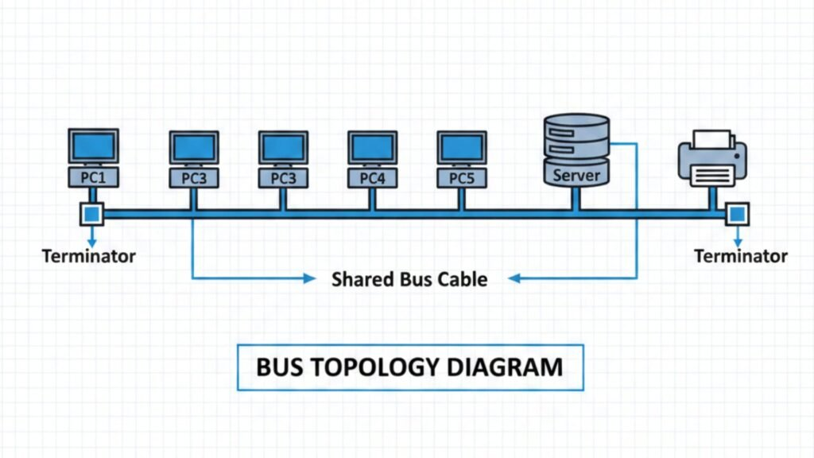

SINGLE BACKBONE CABLE
Bus Topology — Structure & Working
KEY: TERMINATOR
WORKING MECHANISM
1. Broadcast Signal: Sender transmits data along the backbone cable.
2. Address Verification: Nodes inspect target MAC address.
3. Signal Absorption: Terminators absorb signals at cable ends.
PROS
CONS
• Minimum cable required.
• Low setup cost for small labs.
• Backbone break fails network.
• Collisions under heavy traffic.
Note: Terminators absorb electrical signals at cable ends to prevent signal reflection.

Slide 7
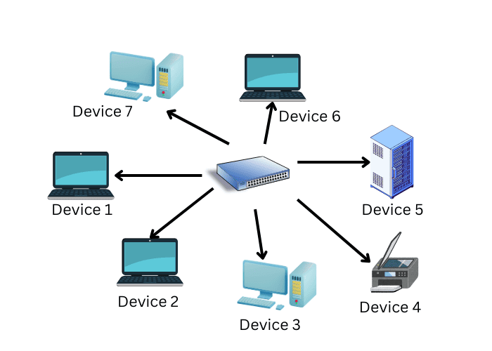
CENTRALIZED CONTROL UNIT
Star Topology — Structure & Working
KEY: CENTRAL SWITCH
WORKING MECHANISM
1. Point-to-Point Link: PC sends packet directly to central Switch.
2. Address Switching: Switch reads MAC address and routes directly.
3. Fault Isolation: Cable failure on 1 PC doesn't affect rest.
PROS
CONS
• Easy fault detection.
• 1 PC failure won't stop lab.
• Switch failure downs whole lab.
• Higher cabling cost.
Real Lab Standard: Most school computer labs deploy Star Topology for easy troubleshooting.

Slide 8
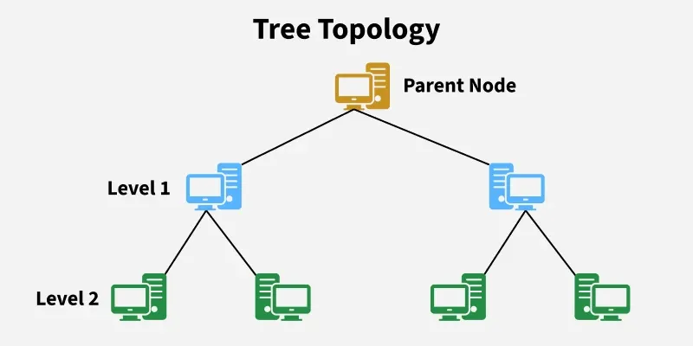
HIERARCHICAL BRANCHES
Tree Topology — Structure & Working
KEY: STAR + BUS TRUNK
WORKING MECHANISM
1. Local Cluster Routing: Intra-building traffic stays in local switch.
2. Inter-Branch Trunking: External data passes up central trunk.
3. Tiered Scalability: New Star clusters easily attach to trunk line.
PROS
CONS
• Highly scalable for campuses.
• Isolates faults by branch.
• High cable & device cost.
• Main trunk failure disconnects branches.
Note: Tree Topology = Bus Topology + Star Topology (Star clusters connected along a central backbone).

Slide 9
Direct Comparison: Bus vs Star vs Tree
Feature | Bus Topology | Star Topology | Tree Topology
Central Core | Single Cable | Switch / Hub | Hierarchical Trunk
Cable Cost | Lowest Cost | Moderate Cost | High Cost
Fault Impact | Cable break downs all | Only 1 PC affected | Branch isolated
Ideal Use Case | Small office / Home | School Computer Lab | Multi-building Campus

Slide 10
Some Important Questions:-
Q1: Which topology connects all workstations to a central Switch/Hub?
STAR TOPOLOGY
Q2: What hardware prevents signal bounce in a Bus topology?
TERMINATORS
Q3: Which topology is best for a large multi-building school campus?
TREE TOPOLOGY

Slide 11
Summary
Bus Topology
Star Topology
Tree Topology
Single backbone cable. Best for low budget small setups.
Central Switch. Standard for school computer labs.
Hierarchical combo. Ideal for large campus networks.
Thank You!
Any questions or discussion points from the teacher or classmates?

